Slide 1
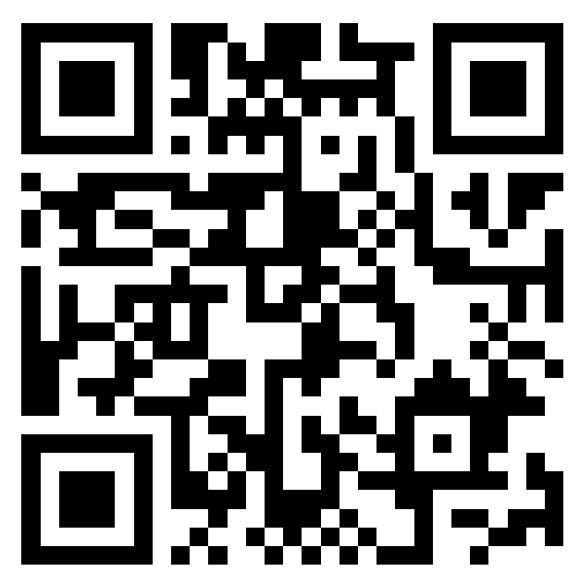

Intro Meeting
September 5th, 2024

Slide 2
Agenda
Executive Board Introductions
AIG Expectations
Overview of Asset Classes
Leadership and Engagement Opportunities
Upcoming Events Timeline
Paid Membership
Adventis Boot Camp Flyer
Q+A Period
Notes:
Agenda /sign in QR code

Slide 3
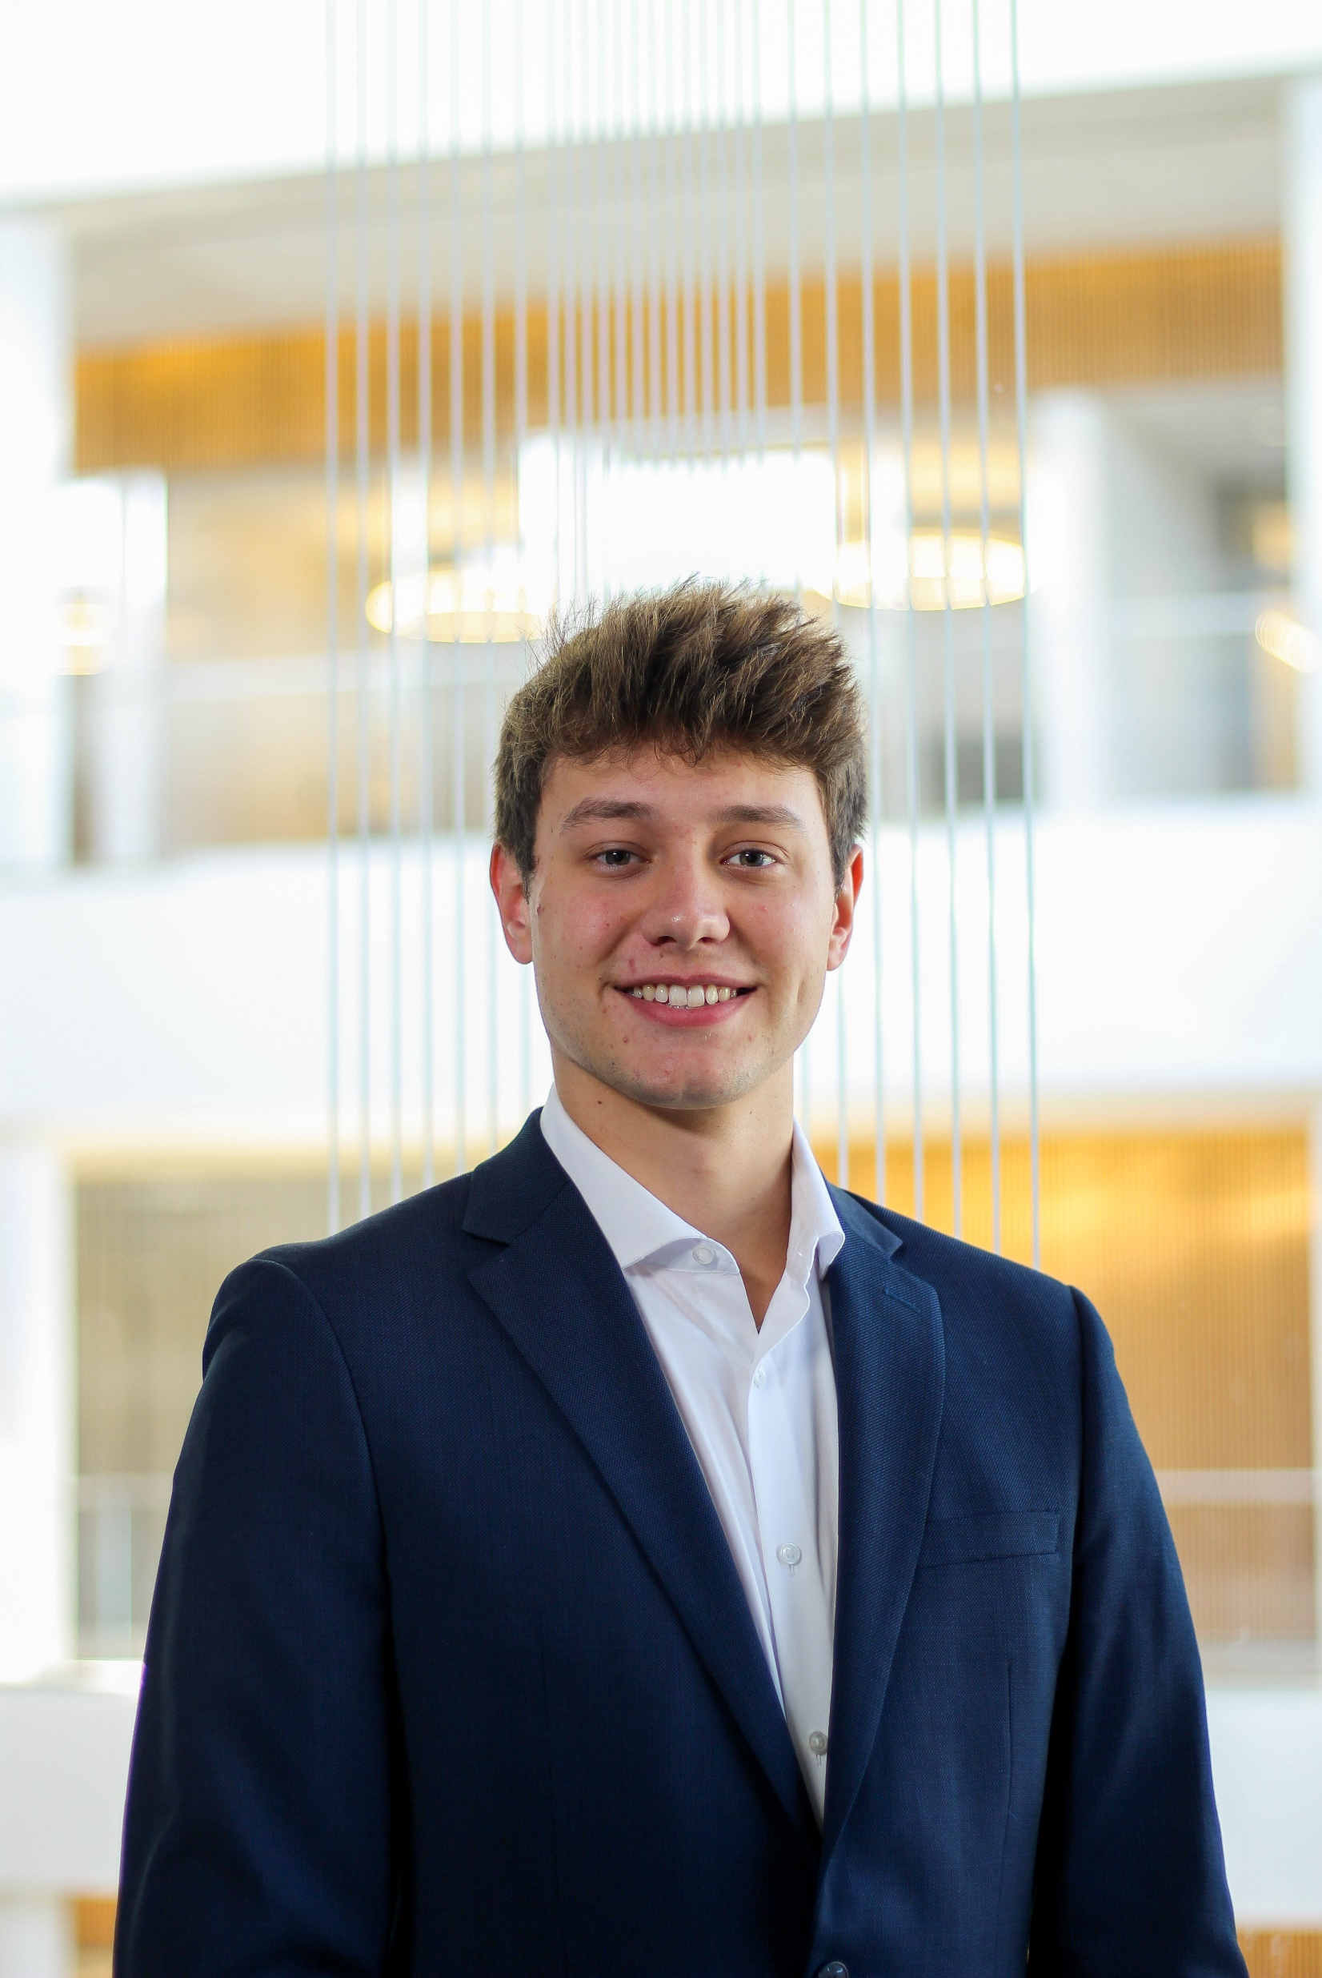
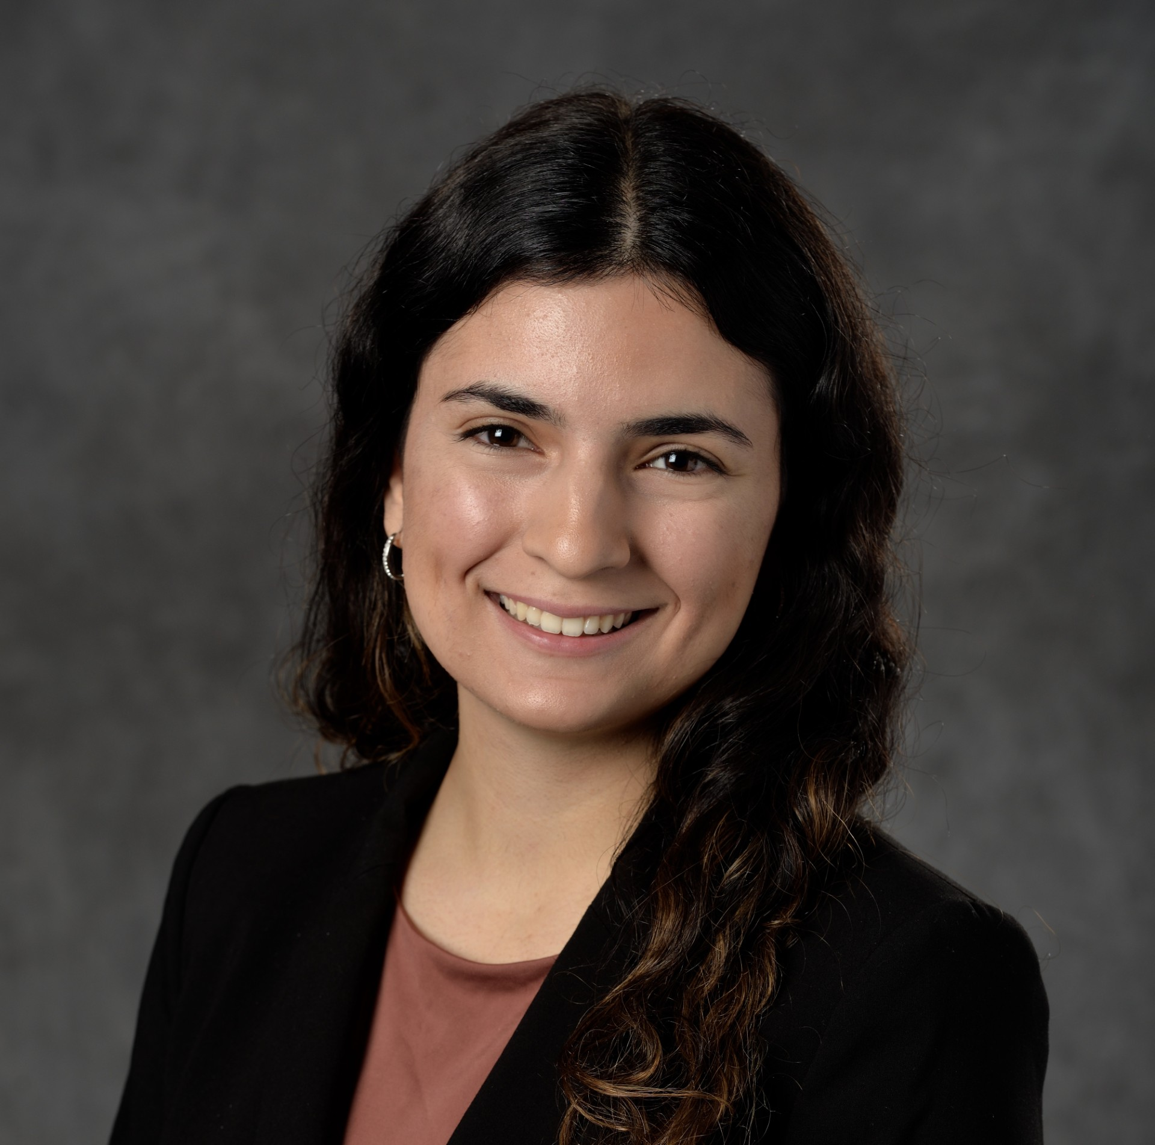
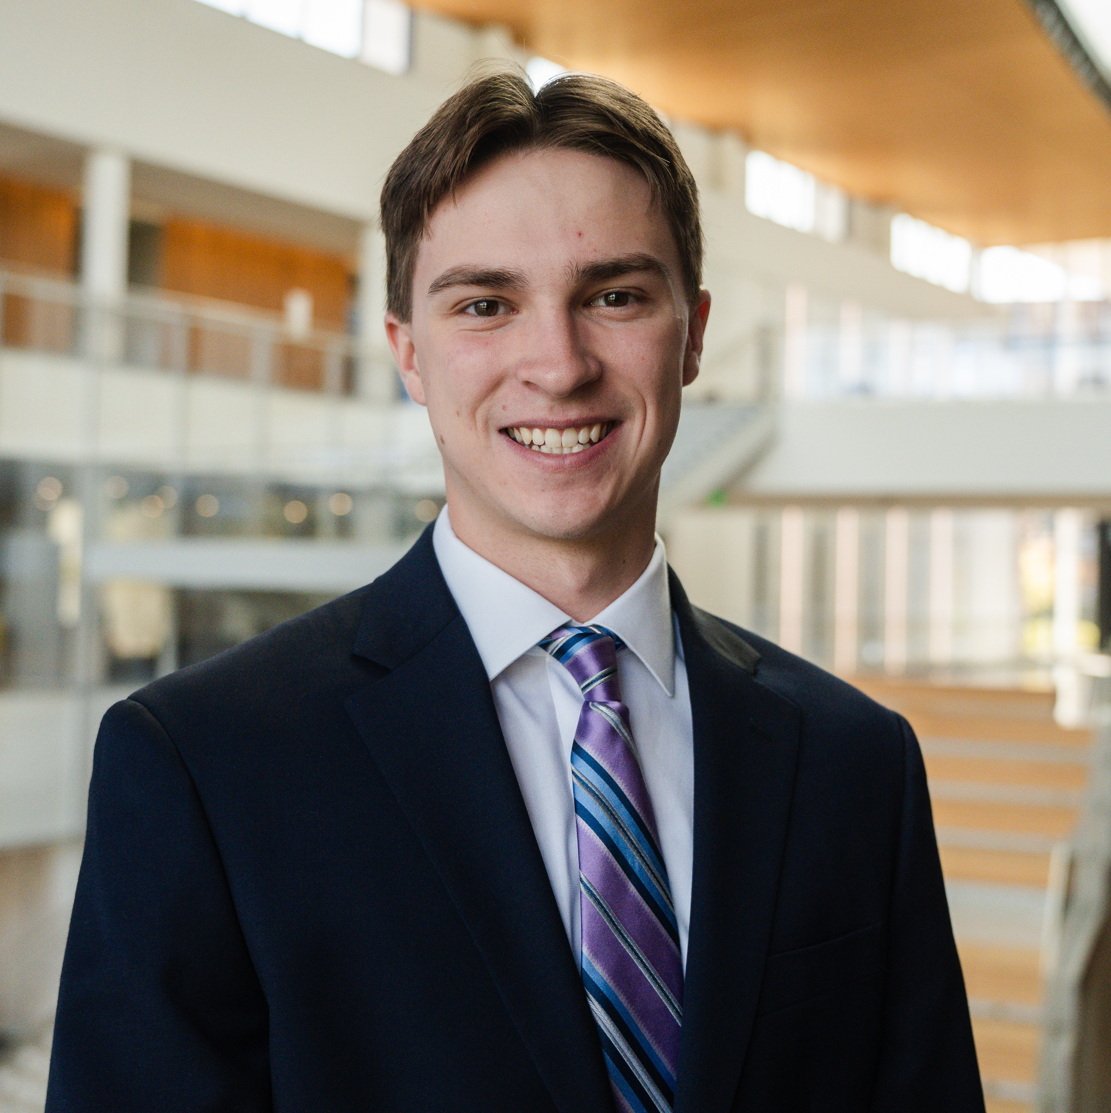

Executive Board Introductions
Dina Younes
President
Dina is a Junior, majoring in Finance with a minor in Real Estate, who did the Girls Who Invest program and interned at the Kresge Foundation.
On campus, Dina is involved in FMI, FA, DWLA, WF, LSA, and Salt.
Next summer, Dina will be at Houlihan Lokey as a Healthcare Investment Banking Summer Analyst in their Chicago office.
Jack Schneider
Vice President
Jack is a Junior, majoring in Finance, who interned at Donnelly Penman & Partners and Providus Capital Partners this summer.
On campus, Jack is involved in FMI and 180 Degrees Consulting.
Next summer, Jack will be at Shore Capital Partners as a Summer Analyst in the Chicago office.
Saransh Mehta
Director of Education
Saransh is a Senior, majoring in Finance and Mechanical Engineering, who interned at Palm Tree in Dallas this summer.
On campus, Saransh is involved in FMI, AIG, the Burgess Institute, the Energy and Automotive Research Lab (EARL), and serves as an RA.
Interned in venture capital with Red Cedar Ventures in Fall 2023.

Slide 4
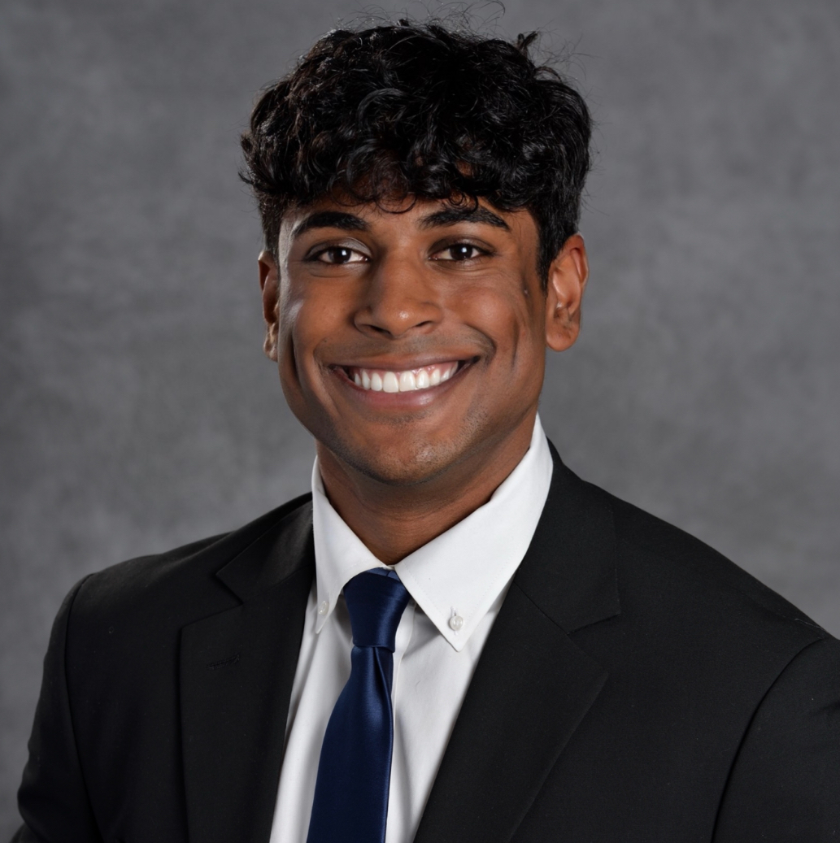
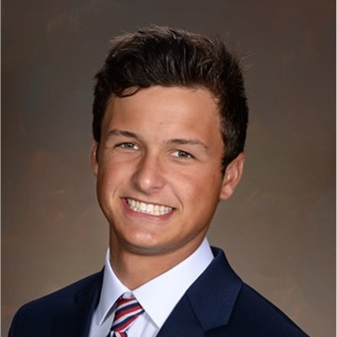
Executive Board Introductions
Yash Reddy
Treasurer
Yash is a Junior majoring in Finance. He recently wrapped up his internship with The Sterling Group, a private equity firm in Dallas, Texas.
On campus, he is involved with SIA, AIG and Spectrum Consulting Group.
Next summer, Yash will be interning at William Blair as a Summer Investment Banking analyst in Chicago, Illinois.
Luke Preston
Head of Business Development
Luke is a Junior majoring in Finance. He recently wrapped up his internship at Auxo Investment Partners, an industrials and manufacturing focused Private Equity firm headquartered in Grand Rapids, Michigan.
On campus, he is involved in the Financial Markets Institute and GWF.
Next summer, he hopes to work in private equity or deal diligence.

Slide 5
AIG Expectations
Meetings: Thursdays 5pm-6pm in Room M200
Attendance: weekly attendance is required for all sector head and analyst positions – Must reach out 24 hours in advance of meeting if unable to attend.
Dress Code: Business Casual.
Educational Series: Sector head and analyst groups will lead a presentation session with an overview of their specific asset class.
Guest Speaker: the following week we will bring in an industry professional as a guest speaker from that asset class.
Professional Development: we will lead resume workshops, case studies, and technical study sessions.
Social Events: we will host social events to strengthen our community.
Notes:
Jack

Slide 6






Asset Classes Covered
Alternative investments are competitive investment strategies that are not open to the public and require a large pool of private capital
Private Equity
Investments in private companies, or buyouts of public companies, resulting in the delisting of the public company.
Hedge Funds
Investment partnership between a hedge fund manager and investors that pool their money together into a fund to maximize returns and mitigate risk.
Venture Capital
Investments in generally high-risk/high-reward startup companies and small businesses.
Private Credit
Non-bank corporate loans that are high-yielding illiquid investments, offered to businesses that are unable to secure financing from traditional bank lenders.
Real Estate
Investments in real estate properties that generate income for investment purposes rather than a primary residence.
Secondaries
Institutional investors who buy existing private equity stakes from current investors for access to mature assets, allowing current limited partners access to liquidity.
Notes:
Dina

Slide 7
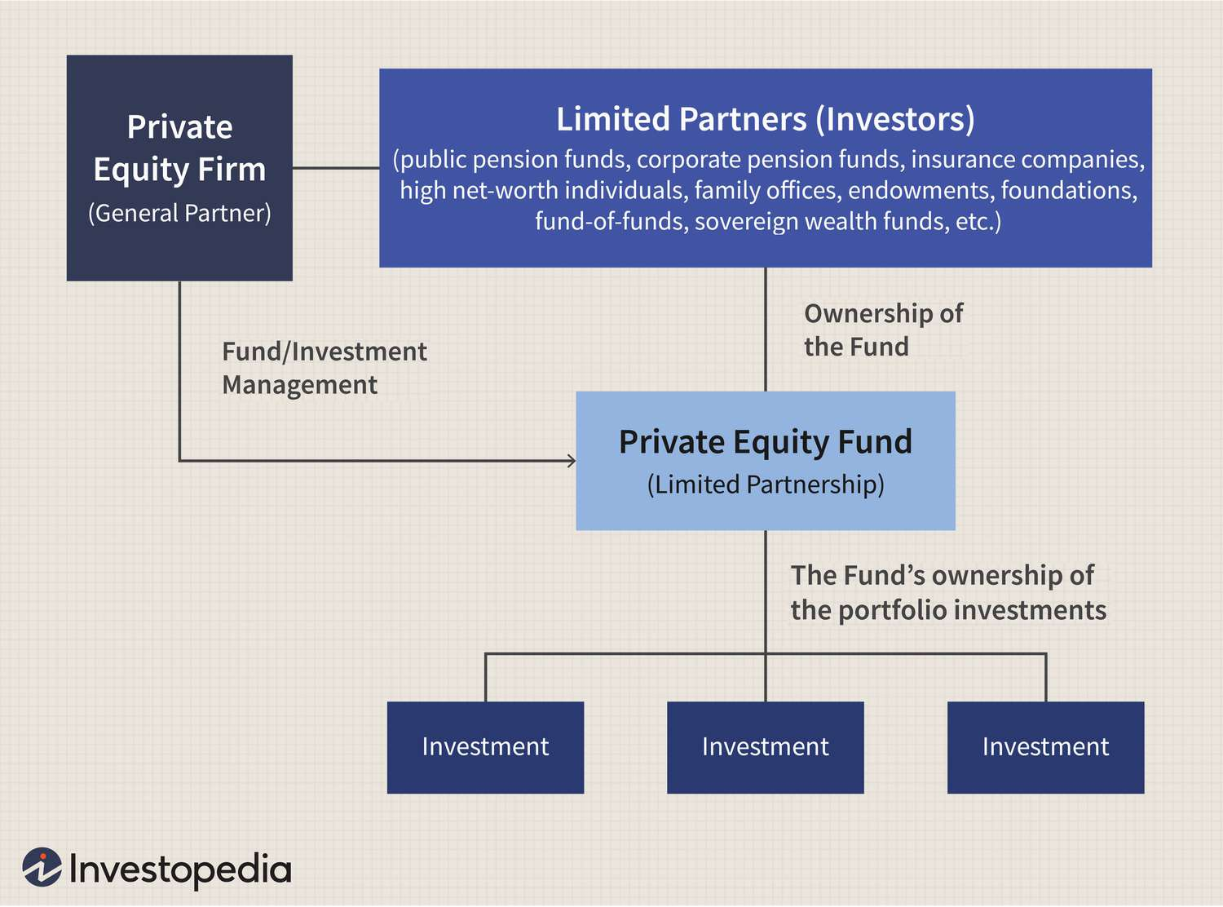



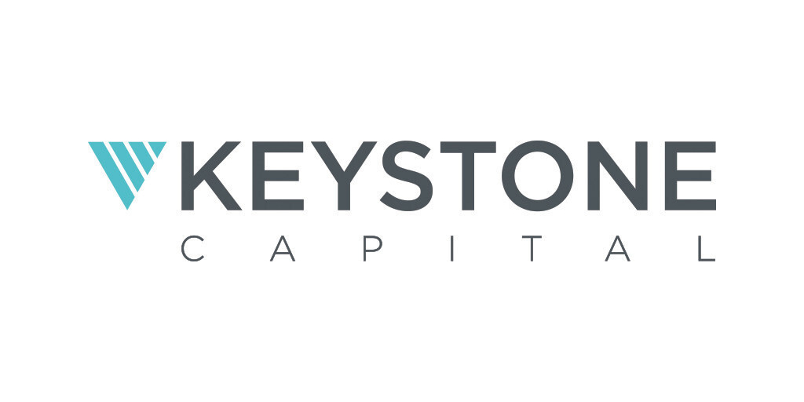


Private Equity Overview
investing in companies to grow and improve them
Private Equity Funds
Private Equity is an alternative investment class that raises capital from limited and general partners to deploy investments in companies.
Funds will manage companies and work to improve profits margins and pay down debt to increase their equity in the portfolio company.
In the buyout of companies, the PE group will often utilize leverage (debt) to amply their returns and return a larger profit to their partners.
Leveraged Buyouts (LBO)
Notes:
Jack

Slide 8





Hedge Fund Overview
High risk-adjusted returns in the public markets
Hedge Funds
Alternative investment funds that raise capital from institutional investors to deploy in securities or other assets across a vast range of markets.
The objective is to produce positive, satisfactory returns for both investors and managers.
How do they achieve their goals?
Utilize a handful of trading techniques and instruments (e.g.: options, shorts, etc.).
Heavy technical security analysis and heavy emphasis on timed moves.
Common strategies include global macro trends, long / short, event driven, and others.
Notes:
Luke

Slide 9


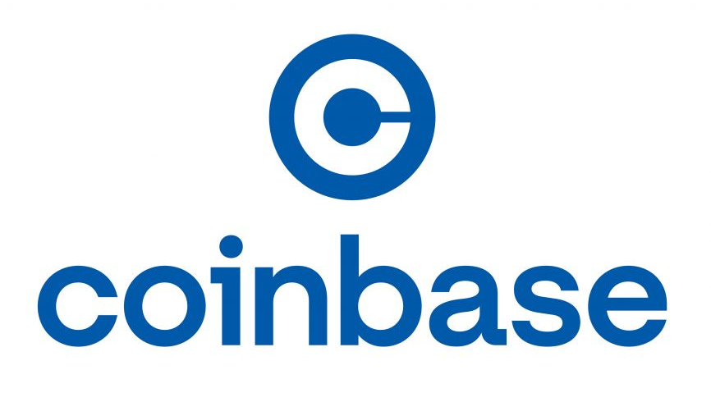






Venture Capital Overview
funding for businesses poised for strong future growth
Venture capital
How do they achieve their goals?
A form of private equity that funds startups and early-stage companies with long-term growth potential.
Types of Venture Capital include pre-seed, seed funding, and early-stage funding.
Take an ownership stake or an active interest in the companies in return for funding.
Their goal is to increase the value of the company, then exit investment by either selling the fund's stake or via an IPO.
Investors
$$$
VC Fund
$$$
Portfolio
Pension Funds
Capital
Invest
Notes:
Saransh

Slide 10
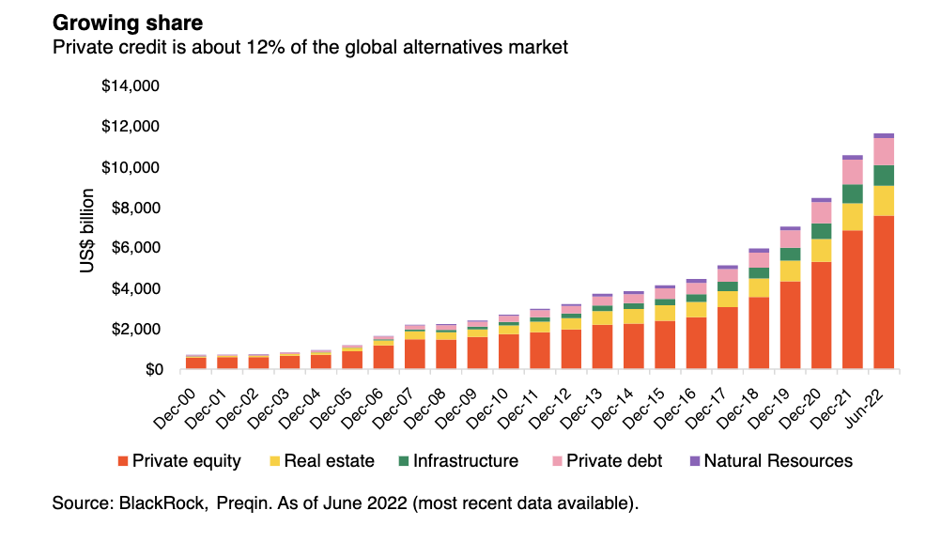
Private Credit Overview
Non-Bank Lending
Private Credit Funds
Private Credit refers to non-bank lending to a privately held company.
These corporate loans are high yielding illiquid investments.
Investor lends money to the company in exchange for interest payments.
Also known as “Direct Lending” or “Private Lending”.
Who do they lend to?
Lending money to companies that are too small to raise money through corporate bonds and unable to get loans from banks.
Companies willing to pay higher interest rate to get money faster and have more flexibility.
Loans to companies that do not have typical needs or good credit ratings.
Notes:
Dina

Slide 11


Real Estate Overview
buying, managing, or developing properties to generate income
Real Easte
Investments in real estate properties that generate income for investment purposes rather than as a primary residence.
Investment groups includes institutional REITs and Private Equity Real Estate firms.
How do they Achieve a return?
Real estate firms often employ a combination of strategies to maximize their returns while managing risk in the dynamic real estate market.
Returns are generated by rental income asset appreciation, and building equity.
Notes:
Yash

Slide 12
Secondaries Overview
Providing liquidity to current investors, gaining access to mature assets
LP-Led Secondaries
GP-Led Secondaries
In a LP-led transaction, a limited partner sells its commitment in a fund to a secondary buyer, who then takes on the rights and obligations of that LP in the existing fund.
In a GP-led transaction, specifically a GP-led single-asset continuation transaction, an asset or portfolio company is transferred from one vehicle to another vehicle, which can offer access to both additional capital and additional time to execute a value-creation plan.
New Investors
$$$
Current Investors
New Investors have ownership in current portfolio companies
Capital
institutional Funds
institutional Funds
Notes:
Jack

Slide 13
AIG Roles
Leadership and Engagement Opportunities
Sector Head Overview
Sector Analyst Overview
Lead a team of 3-4 analysts to build and present educational materials.
Interact with E-Board to shell out decks and produce new ideas.
Act as point of contact for other AIG members looking to learn more about careers and opportunities in your sector.
Work alongside a sector head to build power point presentations and other educational materials.
Learn more about a specific asset class under the direction of a sector head and executive board.
Ideal role for freshmen.
Application Timeline
Thursday 9/5 – Sector Heads Applications Open (Due 9/9 @ 11:59 p.m.).
Week of 9/9 – Sector Head Applications Reviewed & Interviews Conducted.
Thursday 9/19 – Sector Heads Announced & Analyst Applications Open (Due 9/23 @ 11:59 p.m.).
Week of 9/23 & 9/30 - Analyst Applications Reviewed & Interviews Conducted.
Thursday 10/3 - Analyst Groups Introduced and will connect with Sector Heads.
Notes:
Jack

Slide 14
Upcoming Events
Sector Head Application Deadline
Applications Due Monday 9/9 at 11:59pm
Sector Analyst Application Deadline
Applications Due Monday 9/23 at 11:59pm
Senior Student Panel
Thursday 9/19, 5:00pm – 6:00pm, in Room M200
FMI DE&I Panel
Thursday 9/26, 3:30pm – 5:00pm, Multipurpose Room
Buy-side vs. Sell-side overview
Thursday 9/26, 5:00pm – 6:00pm, in Room M200
Hayride With SIA and FA
Thursday 10/24, Andy T’s - details forthcoming
Notes:
Dina

Slide 15
Paid Membership
Membership Benefits
Pricing Options
Access to exclusive slide decks and resources available on AIG website.
Member only Private Equity case study, more details to follow.
Future leadership application eligibility (Sector Analyst/Lead, Executive Board ).
Social events including Hayride with Student investment association and the finance association.
$30 for one academic year
$50 for Lifetime Membership
How to become a paid member
Membership payment instructions will be discussed in forthcoming meetings. Please pay attention to future e-mails for more information. reach out to Yash with any questions or concerns regarding payment.
Notes:
Yash

Slide 16
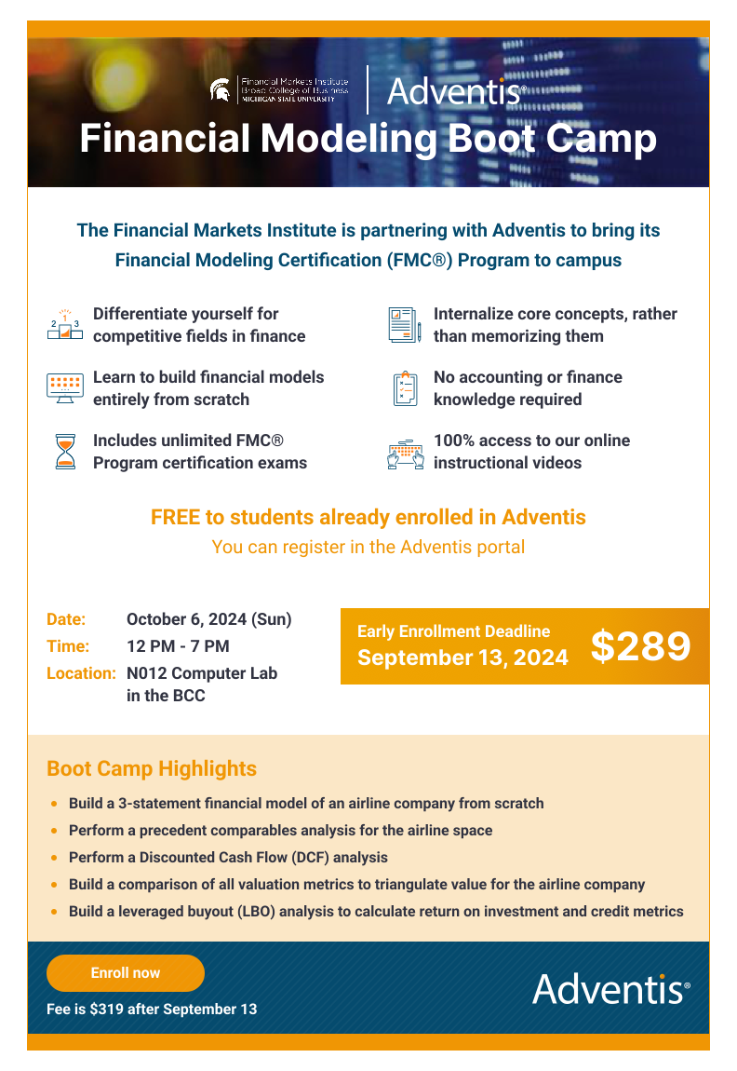
Adventis Financial Modeling Boot Camp
Notes:
Jack

Slide 17
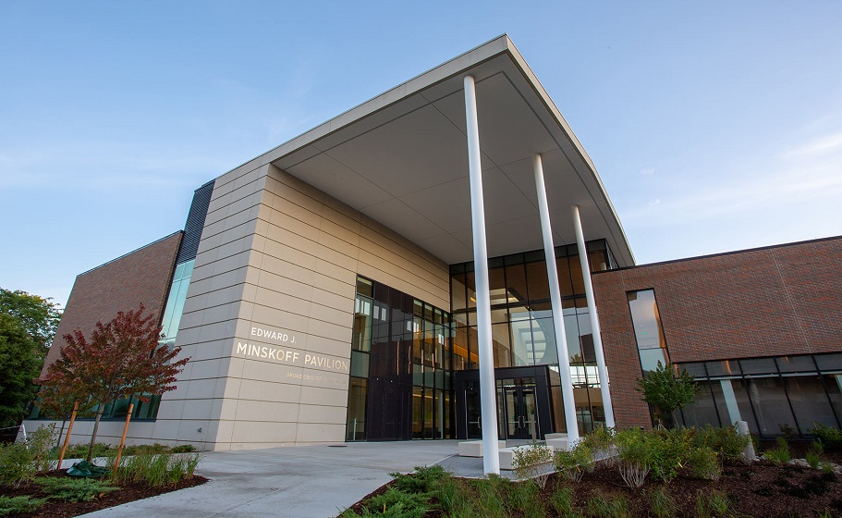

Q&A Period
Dina Younes
President
younesdi@msu.edu
Jack Schneider
Vice President
schne607@msu.edu
Yash Reddy
Treasurer
reddyyas@msu.edu
Luke Preston
Head of Business Development
prest160@msu.edu
Saransh Mehta
Director of Education
mehtasa7@msu.edu
Alternative Investments Group
aigmsu@gmail.com
@aig.msu

